Slide 1
Machine Learning Project on
Object Detection using YOLOv2
-Ruchita Shanbhag

Slide 2
Yolov2
I followed the YOLO9000: Better, Faster, Stronger to implement Yolov2 for Object Detection.
The goal is to emulate the model as described in the paper and train it on the VOC 2012 dataset.
The model works by first splitting the input image into a grid of cells, where each cell is responsible for predicting an arbitrary bounding box.
Each grid cell predicts a bounding box involving the x, y coordinate and the width and height and the confidence score.
A class prediction is also based on each cell.
Yolov2 uses K-means clustering to find the best anchor box sizes for the given dataset by checking for the highest IOU with the bounding box of the object.
Notes:
Each boundary box contains 5 elements: (x, y, w, h) and a box confidence score. The confidence score reflects how likely the box contains an object (objectness) and how accurate is the boundary box. We normalize the bounding box width w and height h by the image width and height. x and y are offsets to the corresponding cell. Hence, x, y, w and h are all between 0 and 1. Each cell has 20 conditional class probabilities. The conditional class probability is the probability that the detected object belongs to a particular class (one probability per category for each cell). So, YOLO’s prediction has a shape of (S, S, B×5 + C) = (7, 7, 2×5 + 20) = (7, 7, 30).

Slide 3
Advancements of Yolov2
Batch Normalization
Batch Normalization is added to all convolutional layers in Yolov2.
2% improvement in mAP.
High Resolution Classifier
After trained by 224×224 images, Yolov2 also uses 448×448 images for fine-tuning the classification network for 10 epochs on VOC 2012 data.
4% increase in mAP.
Convolutions with Anchor Boxes
YOLOv2 removes all fully connected layers and uses anchor boxes to predict bounding boxes.
One pooling layer is removed to increase the resolution of output.
416×416 images are used for training the detection network now.
13×13 feature map output is obtained.
Dimension Clusters:To identify the top-K boundary boxes that have the best coverage for the training data, we run K-means clustering on the training data to locate the centroids of the top-K clusters
Notes:
YOLO v2 used a custom deep architecture darknet-19, an originally 19-layer network supplemented with 11 more layers for object detection. With a 30-layer architecture, YOLO v2 often struggled with small object detections. This was attributed to loss of fine-grained features as the layers downsampled the input.
We change the size of input from 448 * 448 to 416 * 416. This creates a feature map of size 13 * 13 when we downsample it 32x. The idea behind this that there is a good possibility of the object at the center of the feature map.
Remove one pooling layer to get 13 * 13 spatial network instead of 7*7With these changes, the mAP of the model is slightly decreased (from 69.5% to 69.2%) however recall increases from 81% to 88%.

Slide 4
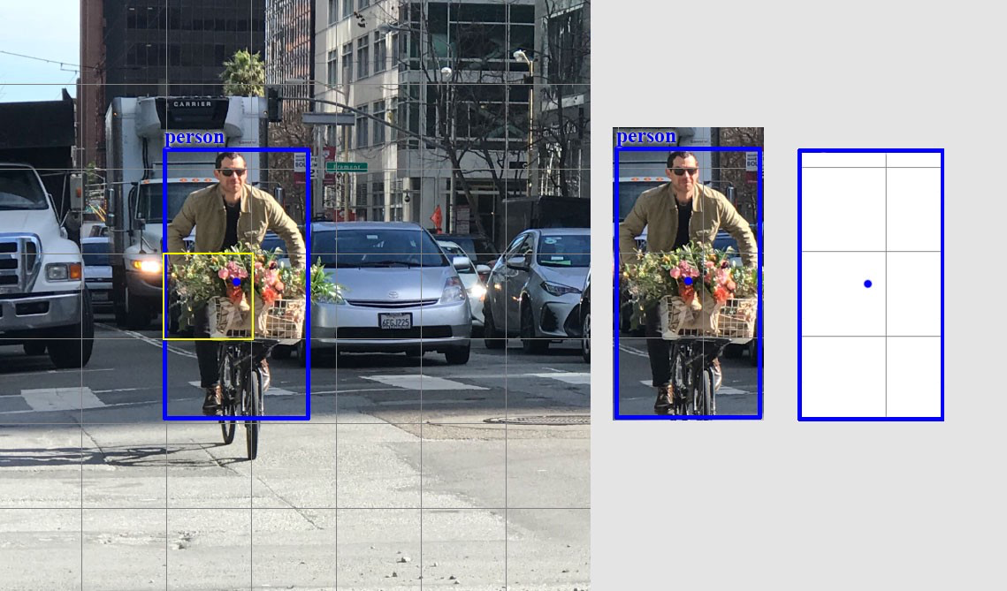
Yolov2 Step 1: Grid Cell Division

Slide 5
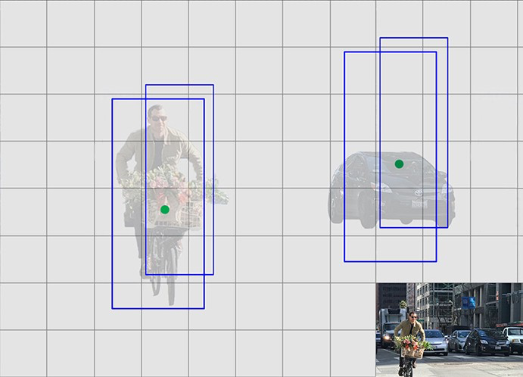
Yolov2 Step 2: Anchor Box Generation
Notes:
Each object in a training image is assigned to grid cell that contains object’s mi`dpoint and anchor box for the grid cell with the highest IoU.
each object has multiple bounding boxes around it. So we define a function to apply non max suppression that chooes the bounding box with the highest IOU.

Slide 6
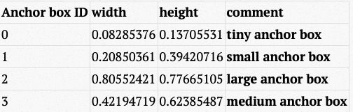
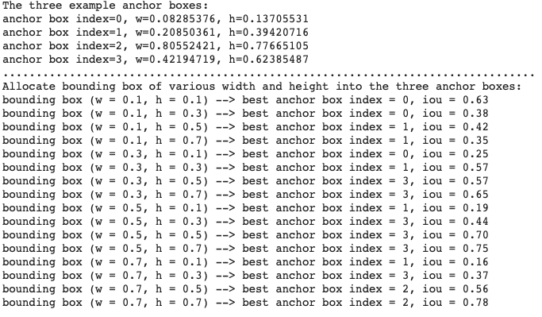
Selection of 4 anchor boxes of following width and height. The width and heights are rescaled in the grid cell scale (Assuming grid size is 13 by 13.)
Assign each object to a ground truth anchor box

Slide 7
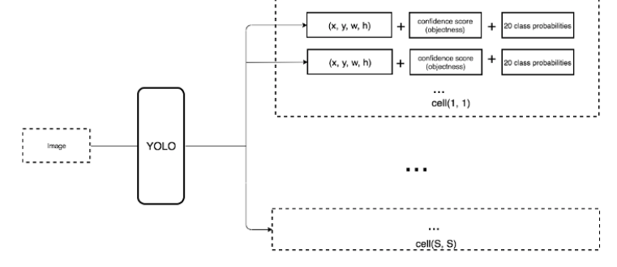
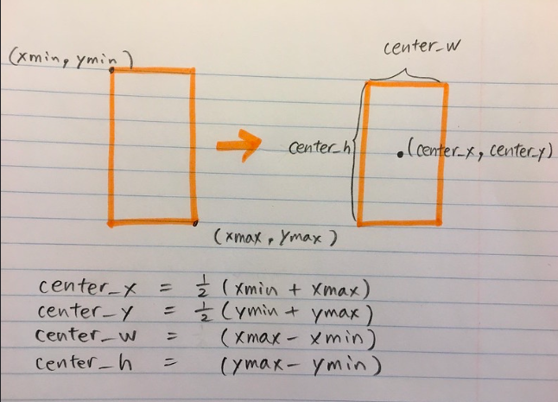
Bounding box encoding
Notes:
The bounding boxes are often defined by 4 parameters: (xmin,ymin, width, height). When we calculate IoU between two bounding boxes, all we care is their width and height. The coordinates of a bounding box, xmin and ymin, are not of concern as we want to only compare the shapes of the bounding boxes.
The input is a (448, 448, 3) image and the output is a (7, 7, 30) tensor. The output is based on S x S x (B * 5 +C).
S X S is the number of grids B is the number of bounding boxes per grid C is the number of predictions per grid

Slide 8
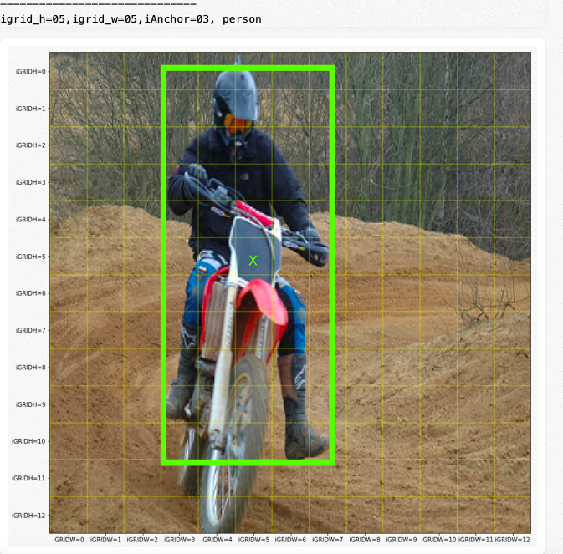
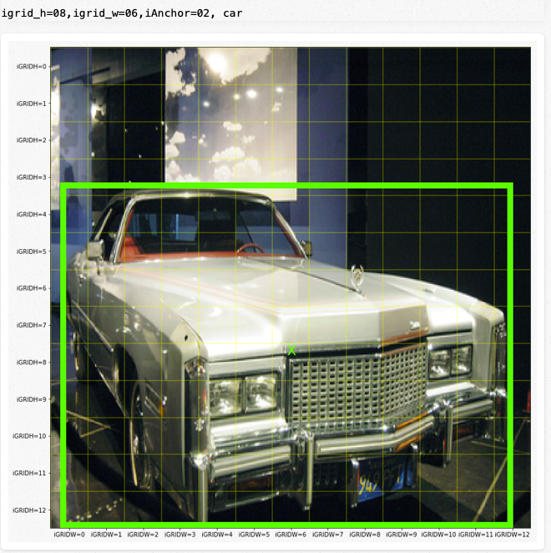

Slide 9
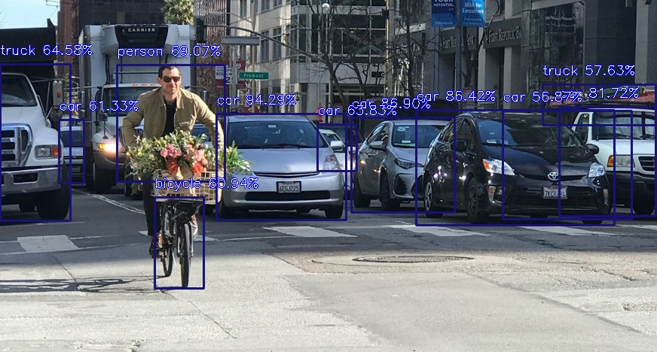
Yolov2 Step 3: Class Prediction
Notes:
Check which (grid cell, Anchor box) pair contains objects

Slide 10
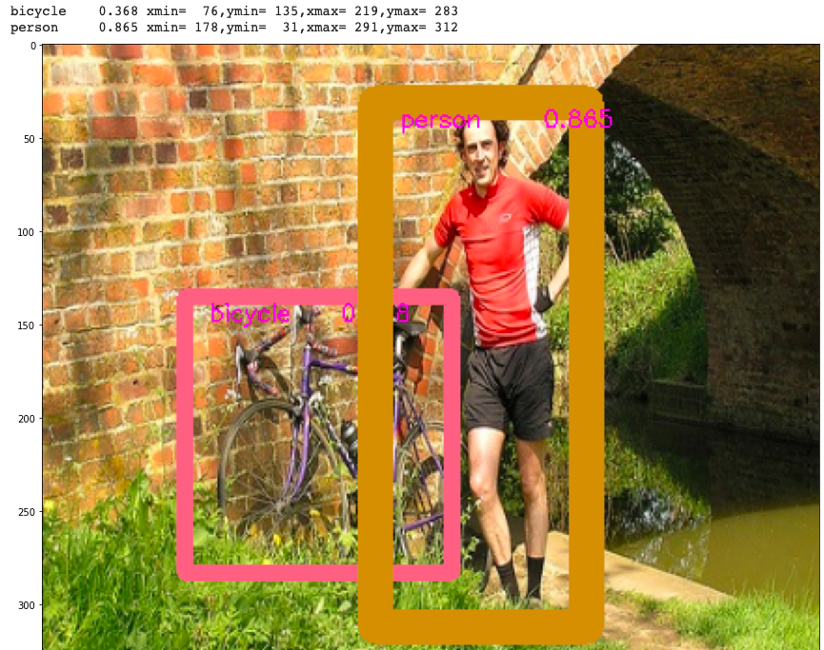
Results

Slide 11
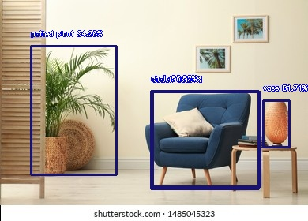
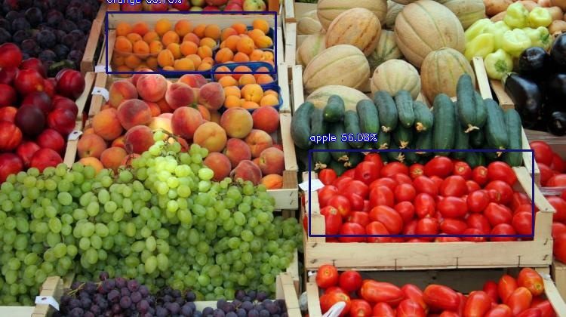

Slide 12
Conclusion
We can further use YOLO 900 to detect objects over 9000 classes using hierarchical classification with a WordTree. It combines samples from COCO and the top 9000 classes from the ImageNet.
Yolov2 struggled with small object detections due to Darknet-19 architecture and was not as accurate and hence Yolov3 can be used to increase the mAp.
YOLO v3 uses a variant of DarkNet, which originally has 53 layer network trained on ImageNet. For the task of detection, 53 more layers are stacked onto it, giving us a 106 layer fully convolutional underlying architecture for YOLO.
Without anchor boxes, the intermediate model got 69.5% mAP and recall of 81%.
With anchor boxes, 69.2% mAP and recall of 88% are obtained. Though mAP is dropped a little, recall is increased by large margin.
At 67 FPS, YOLOv2 can give an mAP of 76.8 while at 40 FPS the detector gives an accuracy of 78.6 mAP, better than the state-of-the-model such as Faster R-CNN and SSD while running significantly faster than those models.
Notes:
At 67 FPS, YOLOv2 can give an mAP of 76.8 while at 40 FPS the detector gives an accuracy of 78.6 mAP, better than the state-of-the-model such as Faster R-CNN and SSD while running significantly faster than those models.

